Slide 1
Understanding Of Previous Year Projects
Group:
Gavin Lewis 101617
Aditya Dsouza 101613
Shantanu Shinde 101651
TIFR- FCRIT

Slide 2
Precision Time Measurement with an Accuracy of Sub-Nanoseconds In Between Collisions

Slide 3
Abstract
The Compact Muon Solenoid (CMS) is a general-purpose detector at the Large Hadron Collider (LHC). It has a broad physics program ranging from studying the Standard Model (including the Higgs boson) to searching for extra dimensions and particles that could make up dark matter. The Compact Muon Solenoid (CMS) experiment is built on the Large Hadron Collider (LHC) at CERN in Switzerland and France. To have a good chance of producing a rare particle, such as a Higgs boson, a very large number of collisions are required.

Slide 4
Time to Digital Converter (TDC)
The aim of this project is to design a time-to-digital converter (TDC), especially intended to measure the delay between successive collisions in a collider with sub nanosecond accuracy. TDC being an important component of the CMS system is essential for accurate collision reconstruction and has great significance in collision detection.
The aim is to do so with the help of a Field Programmable Gate array (FPGA) device. Thus, the time-to-digital converter would be able to take any two signals (start and stop) and find the delay in between them to an accuracy of sub nanoseconds.

Slide 5
Existing Systems
For Coarse Measurement-
In its simplest implementation, a TDC is simply a high-frequency counter that increments every clock cycle.
The time interval T between start and stop for a clock cycle with frequency f is found to be,
T = nT₀
With n, the number of counts and T₀= 1/f the period of the reference clock.

Slide 6
Existing Systems (Continued..)
Limitations of Coarse Counter
The counter implementation accuracy is limited by the clock frequency. If time is measured by whole counts, then the resolution is limited to the clock period. For example, a 10 MHz clock has a resolution of 100 ns.
Greater the clock frequency more is the resolution and more are the number of readings captured. However, higher the clock frequency, higher is the power consumption for the generation and the processing of the clock signal.
To get resolution finer than a clock period, there are time interpolation circuits. These circuits measure the fraction of a clock period: that is, the time between a clock event and the event being measured.

Slide 7
Existing Systems (Continued..)
Fine Counter-
In contrast to the coarse counter, fine measurement methods measure with much better accuracy but far smaller measuring range.
1. Ramp Interpolator - When counting is not feasible because the clock rate would be too high, analog methods can be used. Analog methods are often used to measure intervals that are between 10 and 200 ns. These methods often use a capacitor that is charged during the interval being measured.

Slide 8
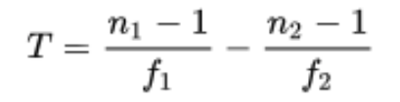
Existing Systems (Continued..)
2. Vernier Interpolator -
The Vernier method is a digital version of the time stretching method. Two only slightly detuned oscillators (with frequencies f 1 and f 2 ) start their signals with the arrival of the start and the stop signal. As soon as the leading edges of the oscillator signals coincide the measurement ends and the number of periods of the oscillators (n 1 and n 2 respectively) lead to the original time interval T:

Slide 9
Existing Systems (Continued..)
3. Tapped Delay Line -
In general a tapped delay line contains a number of cells with well-defined delay times. Propagating through this line the start signal is delayed. The state of the line is sampled at the time of the arrival of the stop signal. This can be realized for example with a line of D-flip-flop cells with a delay time. The start signal propagates through this line of transparent flip-flops and is delayed by a certain number of them. The output of each flip-flop is sampled on the fly. The stop signal latches all flip-flops while propagating through its channel un-delayed and the start signal cannot propagate further. Now the time interval between start and stop signal is proportional to the number of flip-flops that were sampled as transparent.

Slide 10
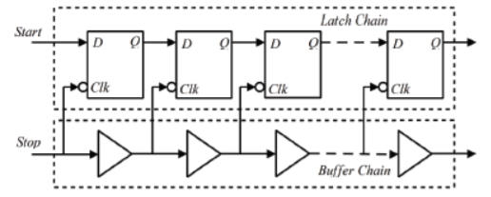

Slide 11
Existing Systems (Continued..)
Hybrid Approach -
Counters can measure long intervals but have limited resolution. Interpolators have high resolution but they cannot measure long intervals. A hybrid approach can achieve both long intervals and high resolution.

Slide 12
Approach
Approach followed in developing the project.

Slide 13
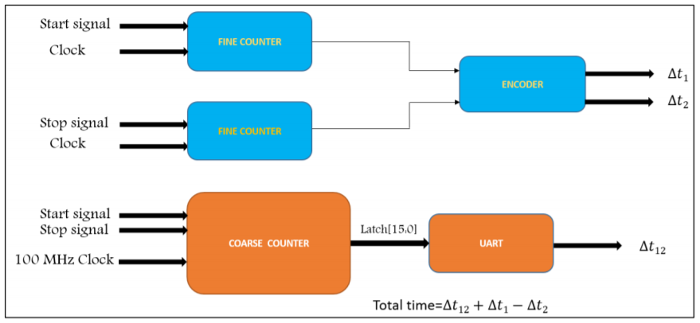
Block Diagram

Slide 14
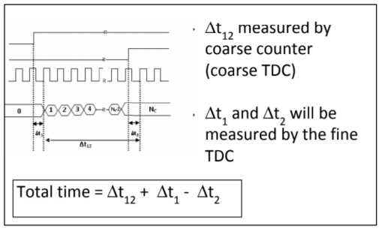

Slide 15
Ship Intrusion Detection System

Slide 16
Abstract
TIFR faces a constant risk of intrusion by sea. Despite there being a closed circuit television (CCTV) or video surveillance system in place, there are limitations on the ability of humans to monitor footage from such a system continuously.
Development of an automated system that would be capable of detection of ships and similar vessels approaching the shore.
The use of machine learning and image processing techniques to detect such intrusion by the sea.
Use of Deep Neural Networks(DNN) and You only look once (YOLO) algorithm to enable real-time dynamic intrusion detection.

Slide 17
Concept Understanding

Slide 18
Deep Learning
Deep learning is a machine learning technique which teaches computers to perform activities that comes naturally to humans and by learning every day to day ventures.
Models are trained by using huge labeled data sets and neural network architectures that contain various layers. Nowadays, deep learning is achieving higher levels of recognition accuracy than ever before.

Slide 19
Convolution Neural Networks
A Convolutional Neural Network, also known as CNN or ConvNet, is a class of neural networks that specializes in processing data that has a grid-like topology, such as an image.
ConvNets learn to detect different features of an image using hundreds of hidden layers. While traversing through the hidden layers it is found that the complexity of the learned image features increases by some extent. ConvNets learn to detect different features of an image using hundreds of hidden layers. While traversing through the hidden layers it is found that the complexity of the learned image features increases by some extent

Slide 20
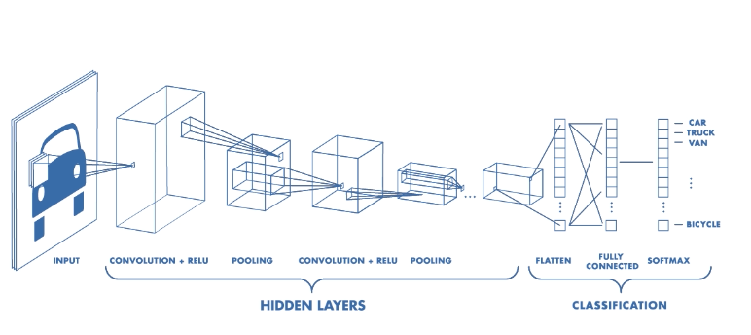
Convolutional Neural Network Architecture
A CNN typically has three layers: a convolutional layer, pooling layer, and fully connected layer.

Slide 21
You Only Look Once (YOLO) Algorithm
Yolo architecture is more like FCNN (fully convolutional neural network) and passes the image (nxn) once through the FCNN and output is (mxm) prediction. This the architecture is splitting the input image in mxm grid and for each grid generation 2 bounding boxes and class probabilities for those bounding boxes. Note that bounding box is more likely to be larger than the grid itself.
Steps in YOLO Algorithm:
Take image input
Divide the image into grid
Apply image classification and localisation to each grid
YOLO then predicts bounding boxes and class probabilities

Slide 22
Vector for Each Grid Cell
Label y is an 8 dimensional vector:
YOLO assigns coordinates to the grid and they are as follows:
y= [pc, bx, by, bh, bw, c1, c2, c3]
Here pc: Whether object is present in the grid
bx, by, bh, bw: Bounding rectangle boundaries.
c1, c2, c3 : predicted class

Slide 23
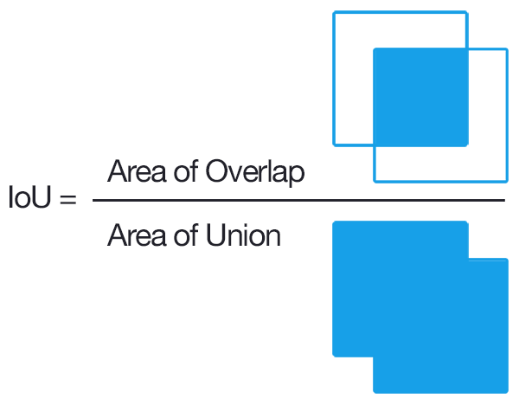
Improving outcome of YOLO
Intersection over Union
Intersection over union is used to decides if the prediction is good or not.
Mathematically,
IoU = Area of the intersection / Area of the union
If IoU is greater than the threshold decided then the prediction can be decided as a good predication.
The threshold can be increased to obtain better predictions.

Slide 24
Improving outcome of YOLO (Continued..)
2. Non-Max Suppression
Non Max Suppression deals with the problem of the detection of a single object multiple times rather than once.
Non max Suppression Technique cleans this up so that there is only a single detection per object.

Slide 25
Approach

Slide 26
Approach
Use of YOLO for both classification and localisation of object using bounding boxes.
Obtain the bounding boxes and encode them in the vectors.
Apply non max suppression to obtain the filtered bounding boxes required.

Slide 27
Gujarati Script Recognition System

Slide 28
Abstract
Gujarati is derived from old Gujarati (circa 1100-1500AD).
Hence, there are many handwritten scripts and articles describing India’s rich tradition.
Paper is highly susceptible to various factors like weather, wear and tear, etc.
Therefore, there is a possibility of losing these invaluable texts over time and with the emergence of the digital era.
In order to preserve it for the upcoming generations, this project was undertaken to digitize those scripts.

Slide 29
Gujarati Language
Gujarati is derived from the Devanagiri script with a major difference of lack of top horizontal line above the words.
Around 50 million Gujarati speakers worldwide.
Written from left to right.
Gujarati has forty-five basic symbols, thirty-four consonants and eleven vowels.
Recognition of Gujarati characters is difficult due to its complex structure and the curve involved in most of the characters.

Slide 30
Algorithms and Techniques

Slide 31
Algorithms Used
Image Preprocessing Algorithms
Segmentation Algorithms
Character Recognition Algorithms

Slide 32
Image Preprocessing Algorithms: Adaptive Thresholding
Thresholding is basically applied to convert a grayscale image to a binary image.
In Fixed thresholding, a pixel value of 127 and greater will be set to 1 and those values lesser than 127 are set to 0.
However, in Adaptive Thresholding, the pixel intensities of the neighbouring pixels is taken into account to decide the threshold value.
This technique can either use the average (mean) pixel values in a bxb region or employ Gaussian weighted average technique to determine the threshold value.

Slide 33
Segmentation Algorithms: K Means Method
A top-down segmentation is applied.
First, the lines are detected, followed by detection of words, followed by detection of characters.
Character detection is performed by calculating the relative spacing between words and each character.
K-means, an unsupervised clustering algorithm is applied here.

Slide 34
Segmentation Algorithms: K Means Method (Continued..)
K means uses measures such as Euclidean distance to cluster an item into the existing clusters.
The value of K is initialized at the beginning which denotes the number of unique centroids and hence, the number of unique clusters.
Each item is then clustered into a cluster with a centroid from which its distance is the least.
The cluster centroids are modified after each item is clustered in order to minimize the sum of the square of the distances from the centroid of each item.
The algorithm stops after a number of iterations (if specified) or if the cluster centroids of two consecutive iterations remain unchanged.

Slide 35
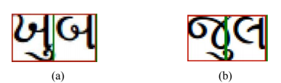
Clustering after removing pixel intensity:
Successful separation using K-means.
Unsuccessful separation using K-means.
In order to overcome the shortcomings of K-means algorithm, re-clustering is done.

Slide 36
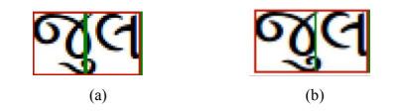
Clustering after removing pixel intensity (Continued..)
All the pixels with intensity value above 79 are converted to 255(white) and those less than 79 are converted to 0(black). This reduces the density of black pixels and better results for clustering can be achieved which overcomes the failures of k-means.
Unsuccessful separation using k means.
Successful separation using k means.

Slide 37
Neural Networks
Set of algorithms that are modelled loosely after the human brain.
Used to recognize patterns.
All real-world data-images, sound, etc are converted into vectors
These vectors are provided as inputs.
Neural networks can also extract features that are fed to other algorithms for clustering and classification..

Slide 38
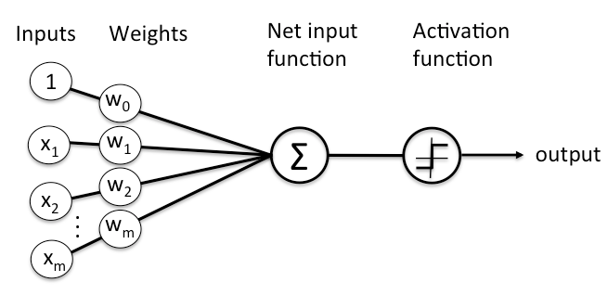
Representation of a neuron ( Perceptron)

Slide 39
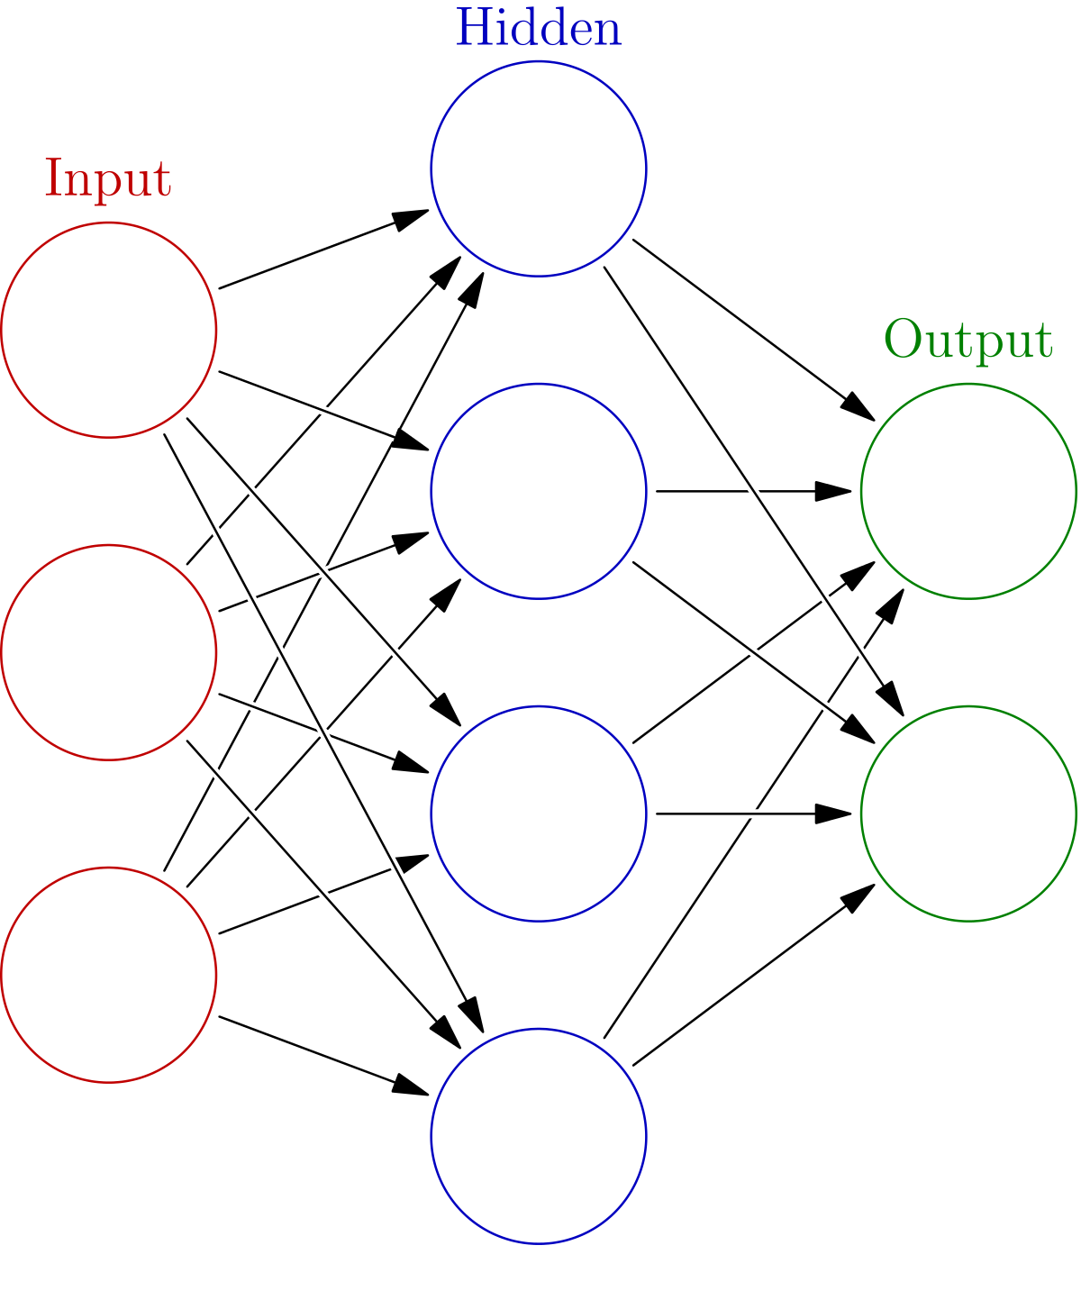
Neural network with one hidden layer

Slide 40
Deep Neural Networks
A Neural Network with 3 or more hidden layers .
In deep learning networks, each layer of nodes trains on a distinct set of features(attributes) based on the previous layer’s output.
The further we advance in the network, the more complex features are recognized by the nodes.
Perhaps, the most distinguishing feature of DNN, is that it performs automatic feature extraction without human intervention.

Slide 41
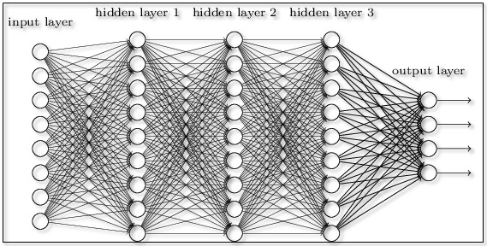
DNN with 3 hidden layers

